Slide 1
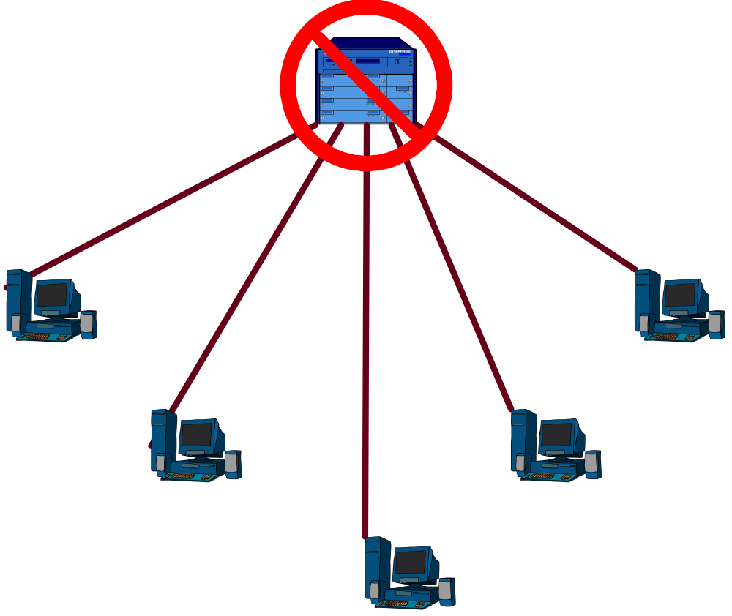
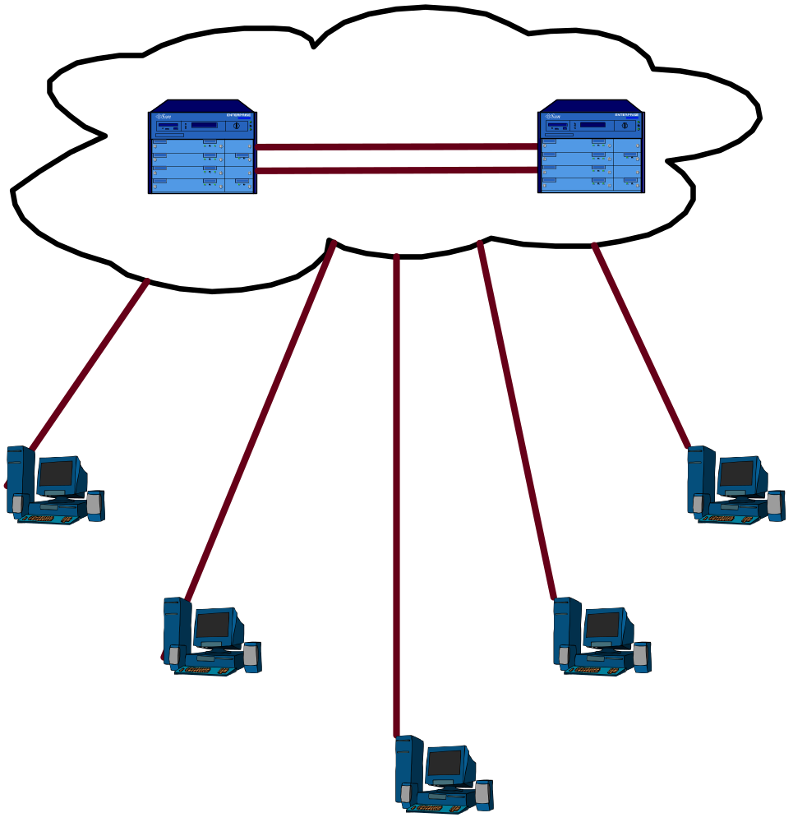

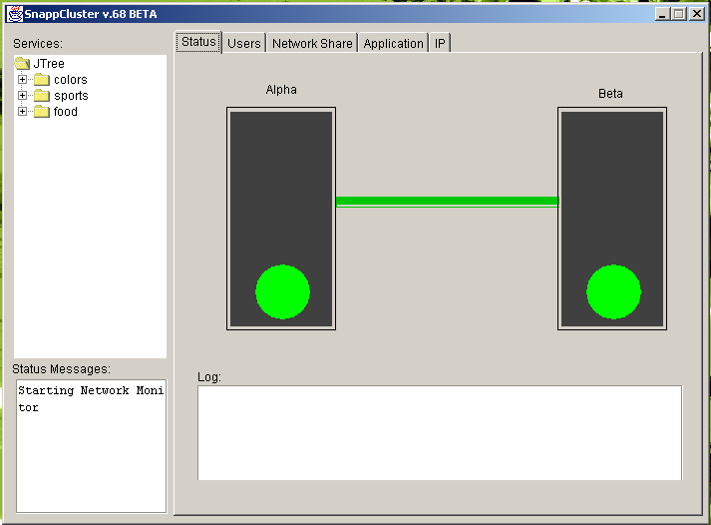
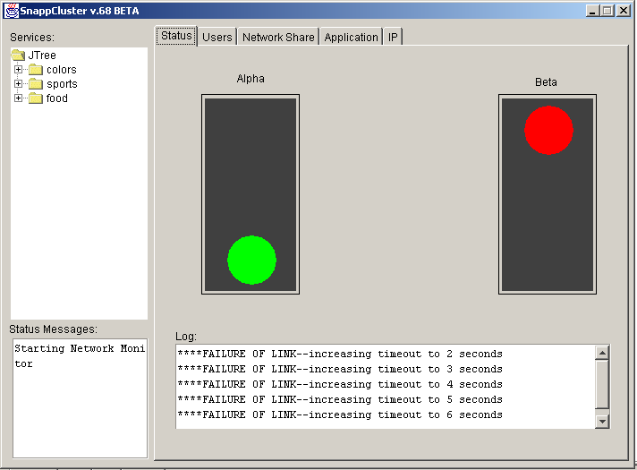
The Problem
  When a server or a service on a server (e.g. email) is no longer available, users are no longer able to get their job done.
  This problem can be solved by connecting multiple servers together to create a cluster.
  The cost to build and maintain a cluster is beyond the resources of most small businesses and schools.
The Solution
  Tailor open-source code to install, configure, and maintain a cluster.
  The install module will automatically detect the hardware on the servers, then install and configure the software with just a few mouse clicks.
  Provide an easy to understand GUI for the administrator that provides important information about the cluster in real-time (e.g. always current).
  The administrator will be able to drill down to display more technical information about the cluster and the services running on the cluster when needed.
Servers are OK
One server is down

